Slide 1
Do enhancer-associated intergenic long noncoding RNAs contribute to nuclear architecture ?
Cyril Matthey-Doret
Supervised by : Jennifer Yihong Tan
Directed by : Ana Claudia Marques

Slide 2
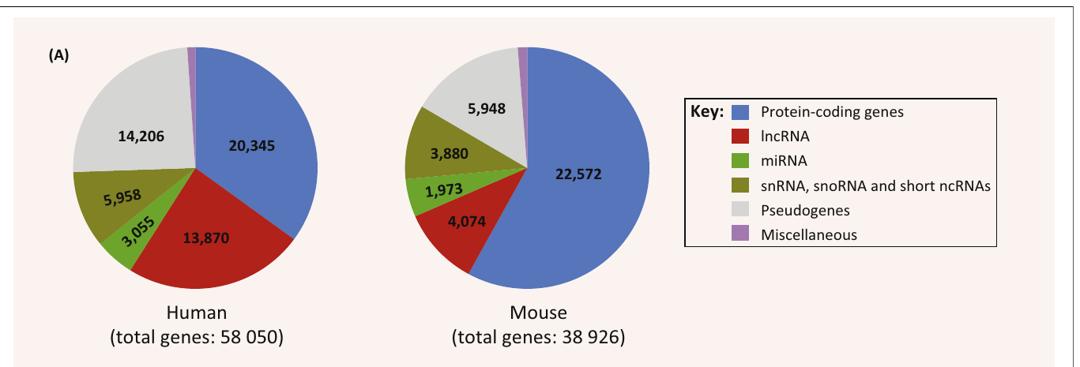
LncRNAs
Long noncoding RNAs
Largest class of noncoding transcript in the human genome
Defined based on length : >200bp
Atianand MK, Fitzgerald KA. Long non-coding RNAs and control of gene expression in the immune system. Trends Mol Med. 2014;20(11):623-31.

Slide 3
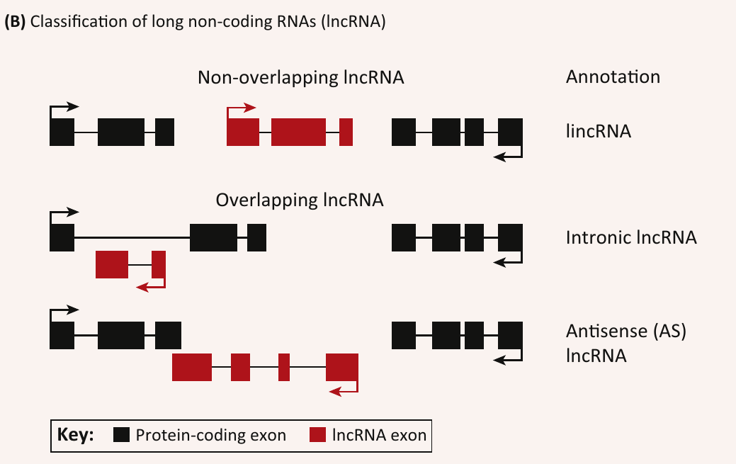
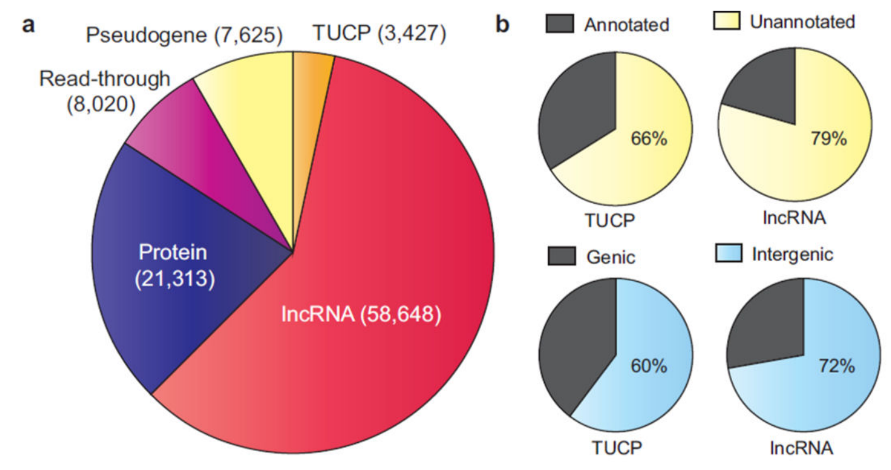
LincRNAs
Long intergenic noncoding RNAs
Do not overlap protein coding genes
Atianand MK, Fitzgerald KA. Long non-coding RNAs and control of gene expression in the immune system. Trends Mol Med. 2014;20(11):623-31.
Iyer MK, Niknafs YS, Malik R, et al. The landscape of long noncoding RNAs in the human transcriptome. Nat Genet. 2015;47(3):199-208.

Slide 4
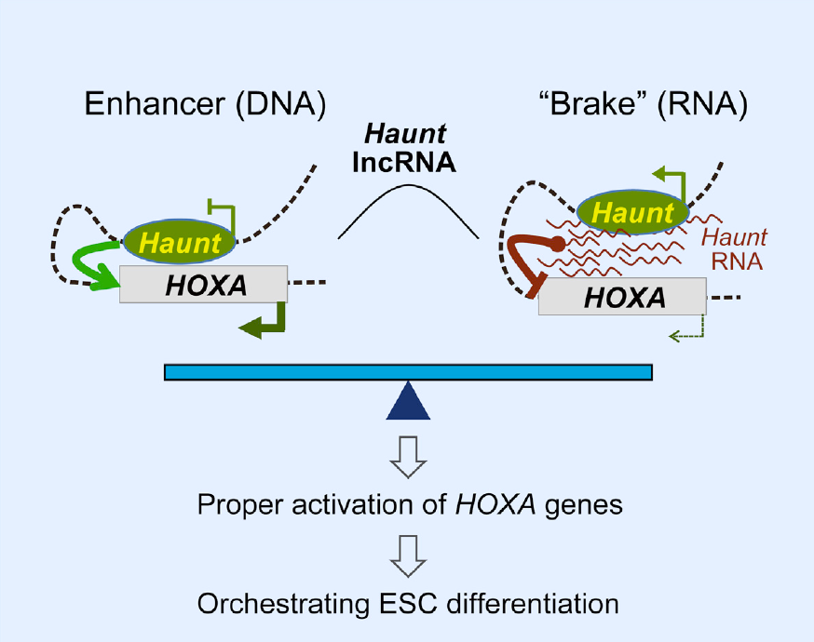
Examples of spatial genome regulation by lincRNAs
Some lincRNAs known to affect chromosomal looping
Other lincRNA involved in large-scale nuclear reorganization (e.g. X-chromsome inactivation)
Yin Y, Yan P, Lu J, et al. Opposing Roles for the lncRNA Haunt and Its Genomic Locus in Regulating HOXA Gene Activation during Embryonic Stem Cell Differentiation. Cell Stem Cell. 2015;16(5):504-16.

Slide 5
Human trait related lincRNAs
Trait-related lincRNAs are associated with :
regions of higher DNA-DNA contacts
Regions with enhancer-like signatures
Do lincRNAs arising from enhancers have a role in the regulation of DNA-DNA contacts ?

Slide 6
Addressing the question
Defining enhancer-associated lincRNAs (elincRNAs)
Characterizing elincRNAs and comparing with other lincRNAs
Testing if elincRNAs in particular are associated with DNA-DNA contacts

Slide 7
ElincRNAs : Definition
Promoter region overlapping enhancers
Definitions based on regulatory elements in GM12878 LCL.
Comparison with « other lincRNAs »
Class | Overlap | Number
elinc | Enhancers only | 236
plinc | Promoters only | 480
other | none | 1756

Slide 8
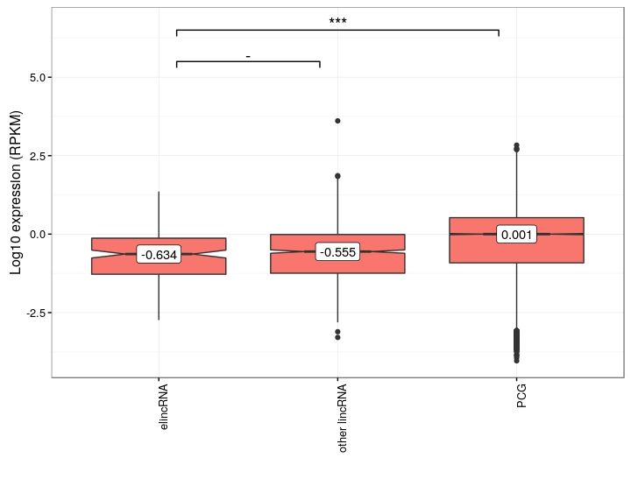
Expression levels
The median expression levels of elincRNAs is similar to other lincRNA

Slide 9
Similar expression levels
Literature shows lower expression levels for eRNAs in general
Absence of difference in elincRNAs may be related to their distinct features :
Polyadenylation
Unidirectional transcription
Splicing

Slide 10
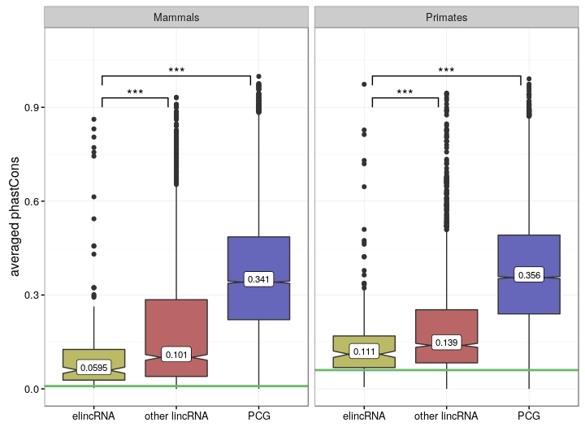
Sequence conservation
ElincRNAs show a lower sequence conservation than other lincRNAs
Median conservation of Ancestral repeats (neutral evolution)

Slide 11
Low sequence conservation
ElincRNAs have under near neutral selection during mammalian and primate evolution.
Low sequence conservation suggests elincRNAs transcripts tend to be less functionally important
Points towards a transcription-dependent function rather than transcript-dependent.
But recent studies showed evidence for conservation in recent human evolution (Tan et al. 2016)

Slide 12
ElincRNAs and DNA-DNA contacts
How is the genome organized in space ?
How does one measure DNA-DNA contacts ?
How do these DNA-DNA contact relate to elincRNAs ?

Slide 13
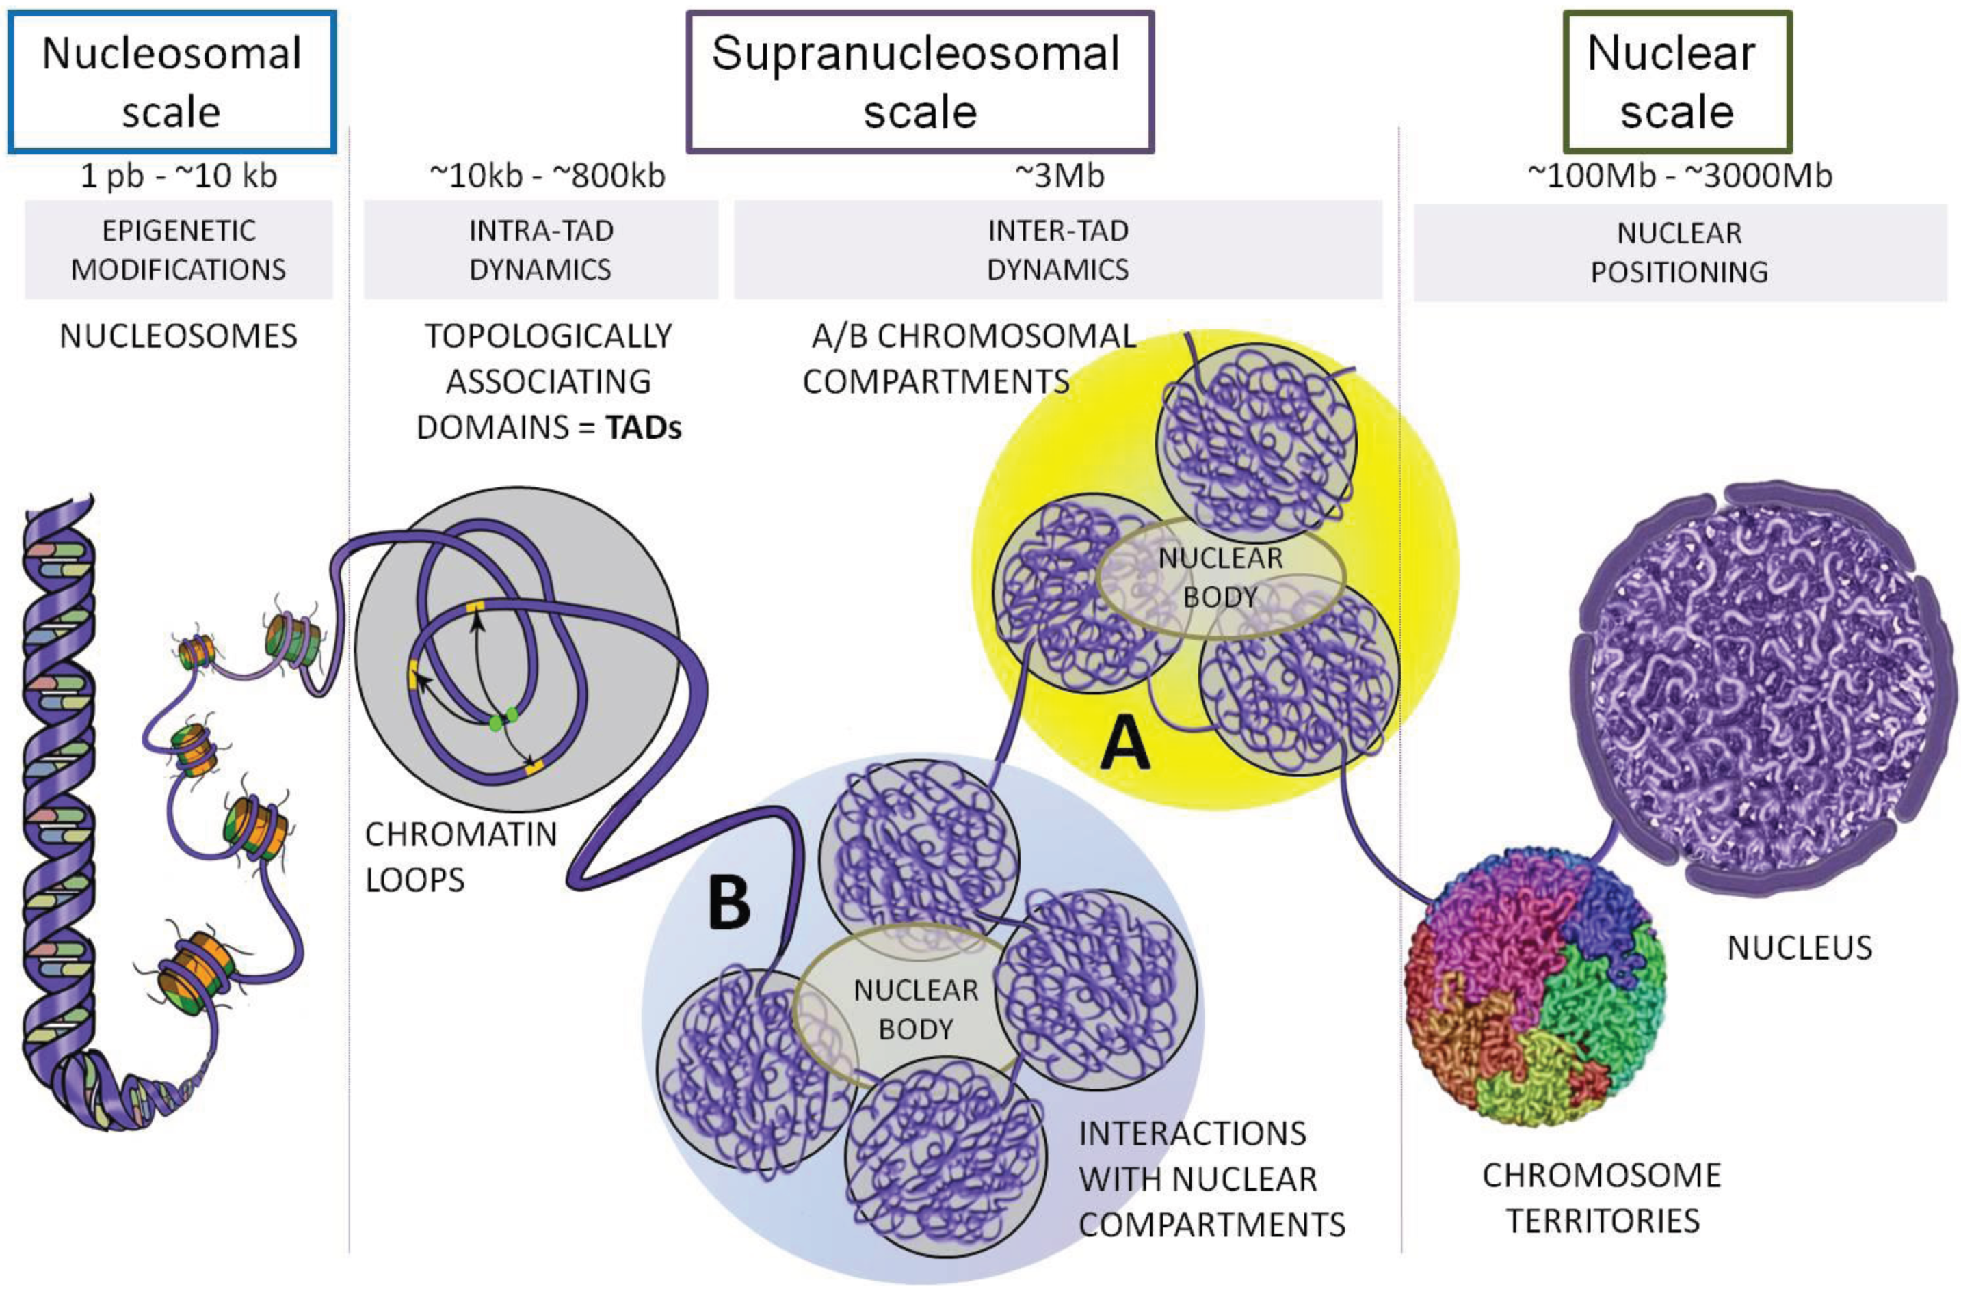
The 3D genome
The genome is folded into compact structures
Ea V, Baudement MO, Lesne A, Forné T. Contribution of Topological Domains and Loop Formation to 3D Chromatin Organization. Genes (Basel). 2015;6(3):734-50.

Slide 14
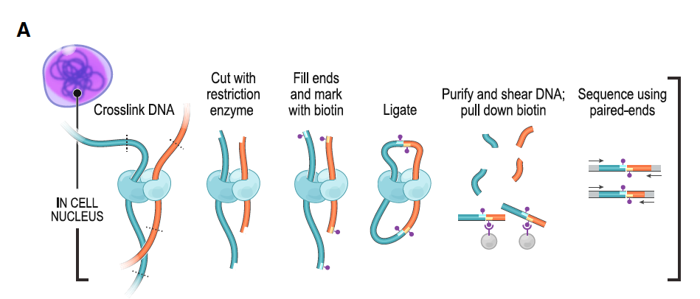
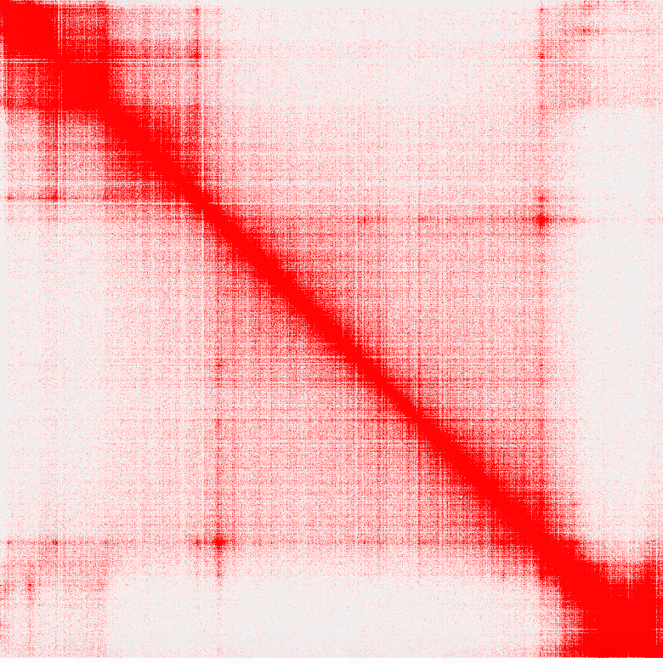
Hi-C technology
Genome-wide chromosome conformation capture
Allows to map all interactions in the genome up to 5kb resolution
Rao et al, 2014. A 3D map of the human genome at kilobase resolution reveals principles of chromatin looping. Cell

Slide 15
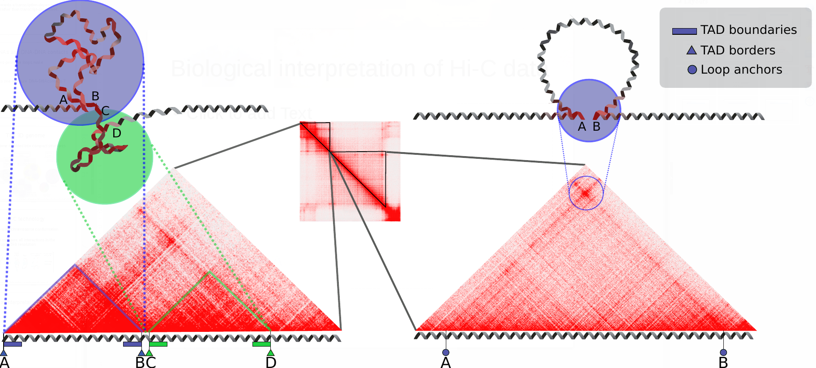
Biological interpretation of Hi-C data
TADs and loops show distinct patterns

Slide 16
TAD boundaries
Regions around the borders of TADs
Promote intra-TAD contacts and prevent inter-TAD contacts
Enriched in insulator proteins CTCF and cohesin

Slide 17
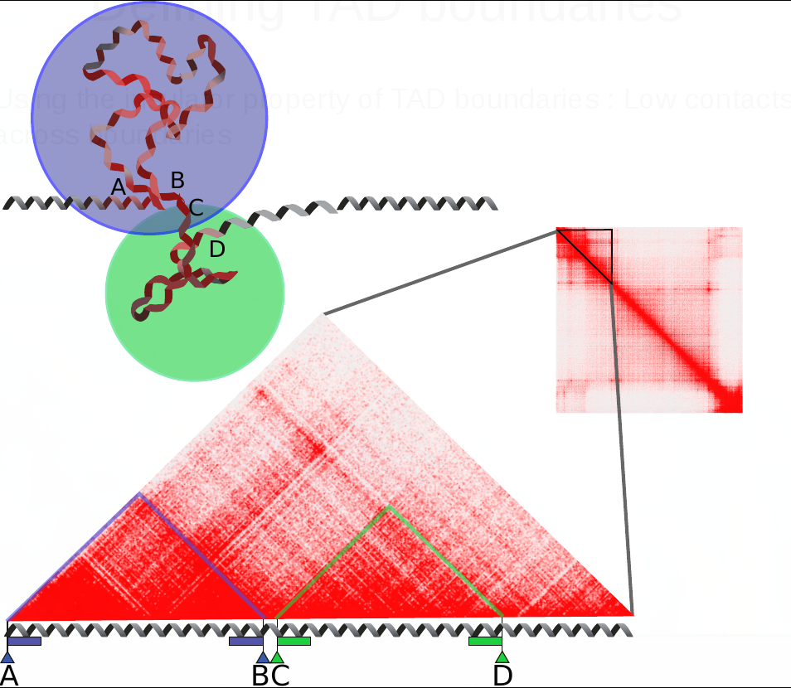
Defining TAD boundaries
Using the insulator property of TAD boundaries : Low contacts across boundaries

Slide 18
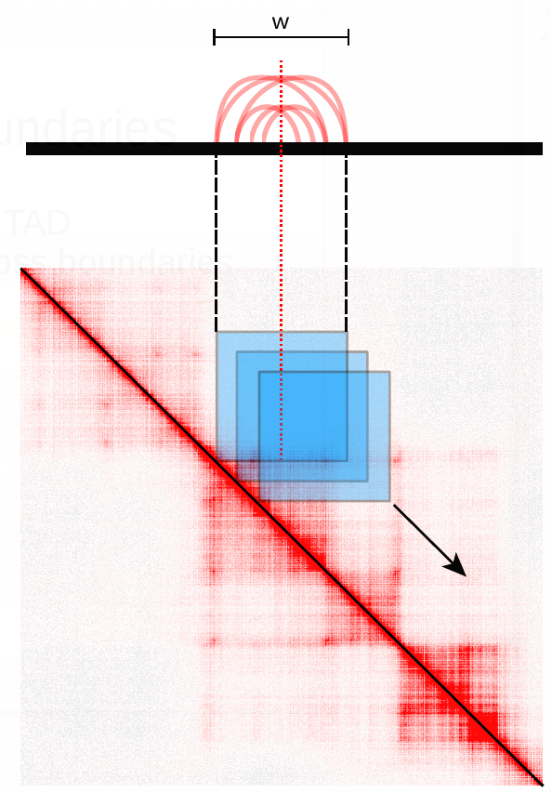
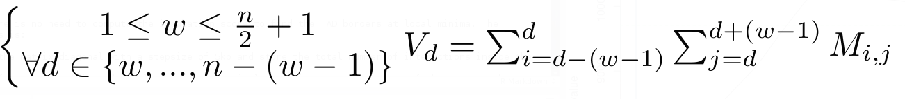
Defining TAD boundaries
Compute contacts across every position « d »
in the genome at a maximum range of « w ».
Diamond of width « w » slides along
the diagonal.
w : arbitrary threshold set to 100kb
V : measure of insulation for every position
along the diagonal
1
n

Slide 19
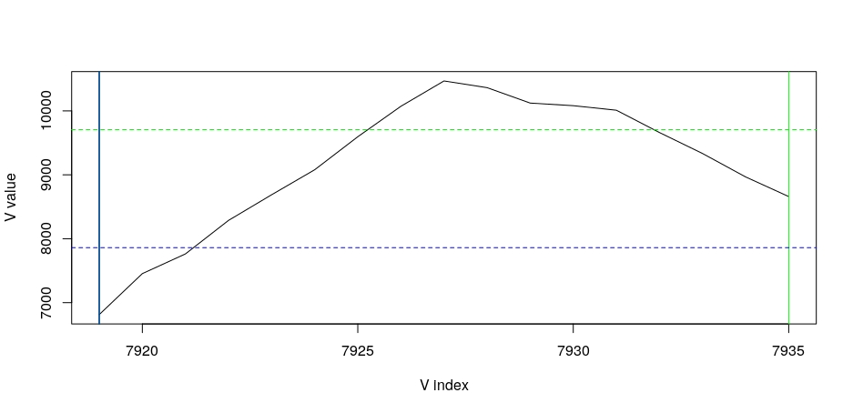
Defining TAD boundaries
For every TAD, boundaries are extended inwards from the borders until the value of V_{d} reaches a defined threshold.
boundary
boundary
TAD

Slide 20
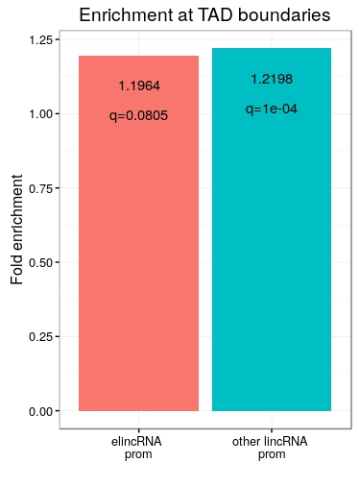
ElincRNAs are not enriched at TAD boundaries
Using custom-defined boundaries, elincRNAs are not enrichmed at TAD boundaries compared to other lincRNAs.
Both are located slightly more
than random at boundaries.

Slide 21
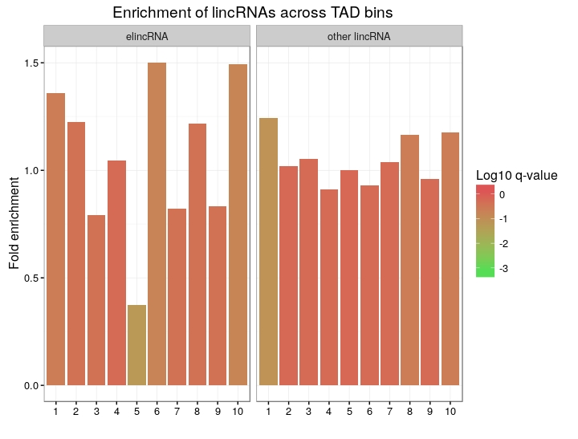
ElincRNAs are not enriched at TAD boundaries
Double check with a more simple approach
Dividing TADs into 10 equally-sized bins.
No significant enrichment, but there is a trend.

Slide 22
ElincRNAs are not enriched at TAD boundaries
Double check with a more simple approach
Dividing TADs into 10 equally-sized bins.
No significant enrichment, but there is a trend.
Strong depletion at the center
0.37 fold, q=0.055

Slide 23
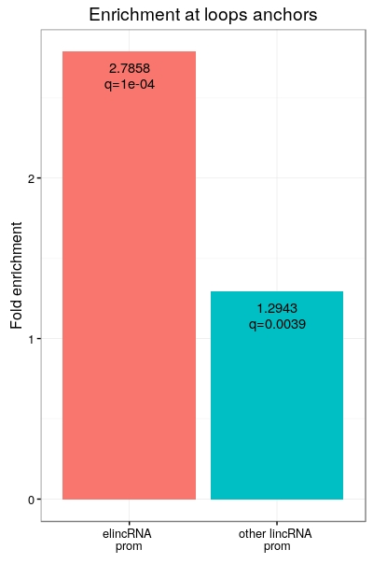
ElincRNAs are enriched at loop anchors
Promoter regions of elincRNAs are strongly enriched at loop anchors compared to other lincRNAs
Supporting association between
elincRNAs and loop formation ?

Slide 24
Measuring intraTAD contacts
Measuring all contacts happening inside very TAD.
Normalizing by TAD length
(mean contact per 5kb).
Each gene is assigned the value
of the TAD it belongs to.

Slide 25
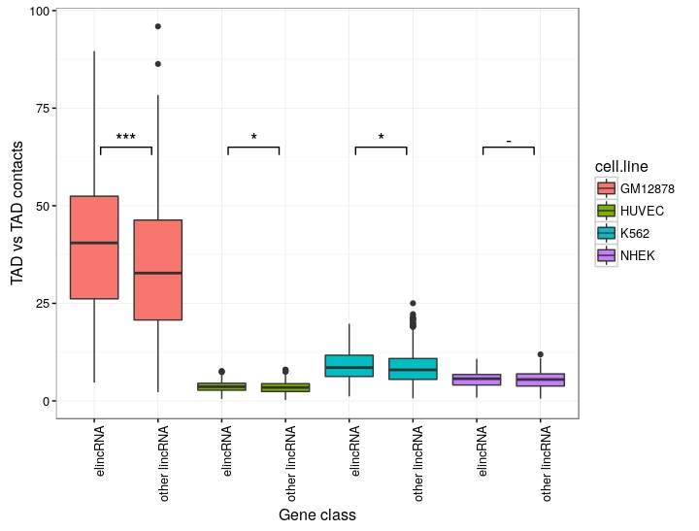
ElincRNAs belong to higher contact TADs
ElincRNAs are associated with higher DNA-DNA contacts TADs than other lincRNAs
Transcription of elincRNAs promoting TAD compaction ?

Slide 26
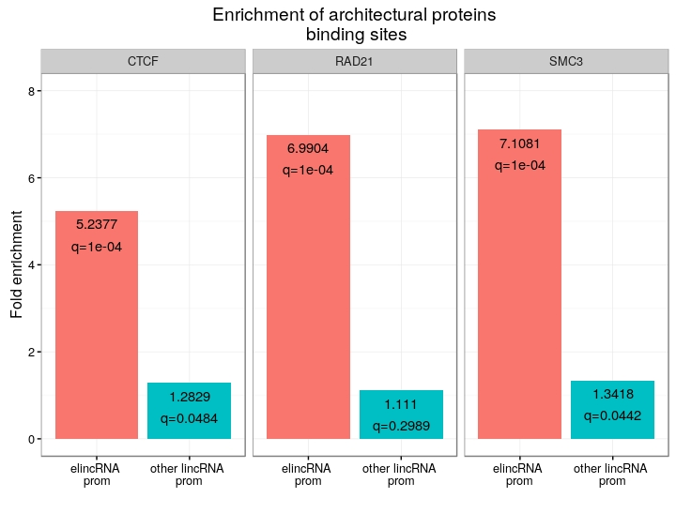
ElincRNAs enriched in insulator proteins
CTCF and cohesin (RAD21 and SMC3) are enriched in elincRNAs promoter regions compared to other lincRNAs.

Slide 27
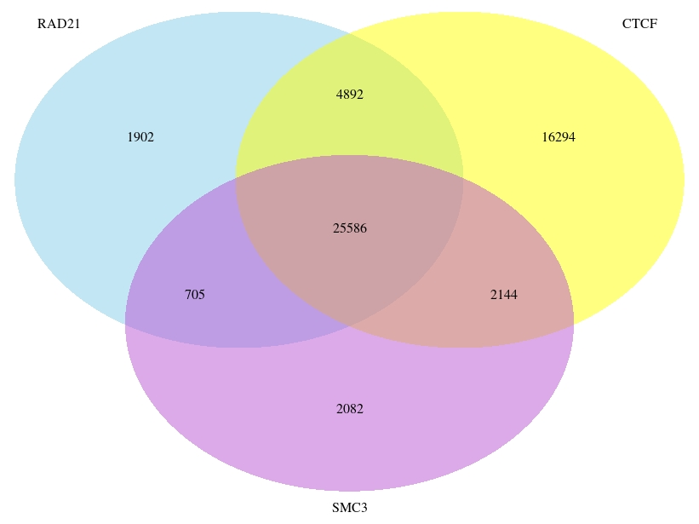
CTCF and cohesin peaks overlap
CTCF and cohesin peak regions largely overlap
Is the enrichment still present at CTCF-only peaks ?

Slide 28
CTCF and cohesin peaks overlap
CTCF and cohesin peak regions largely overlap
Is the enrichment still present at CTCF-only peaks ?

Slide 29
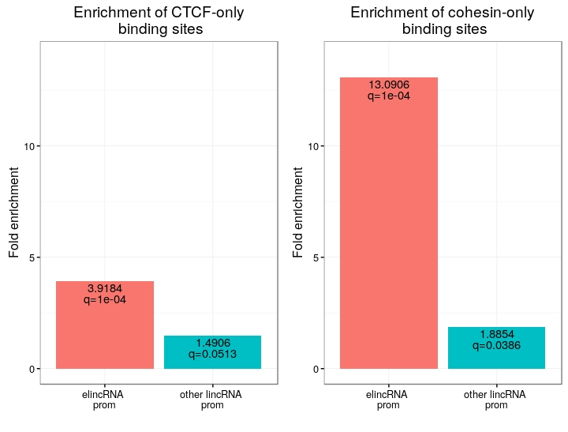
ElincRNAs strongly enriched in cohesin-only peaks
The promoter regions of elincRNAs show a very strong enrichment for cohesin exclusive peaks compared to other lincRNAs
This is not the case
for CTCF peaks

Slide 30
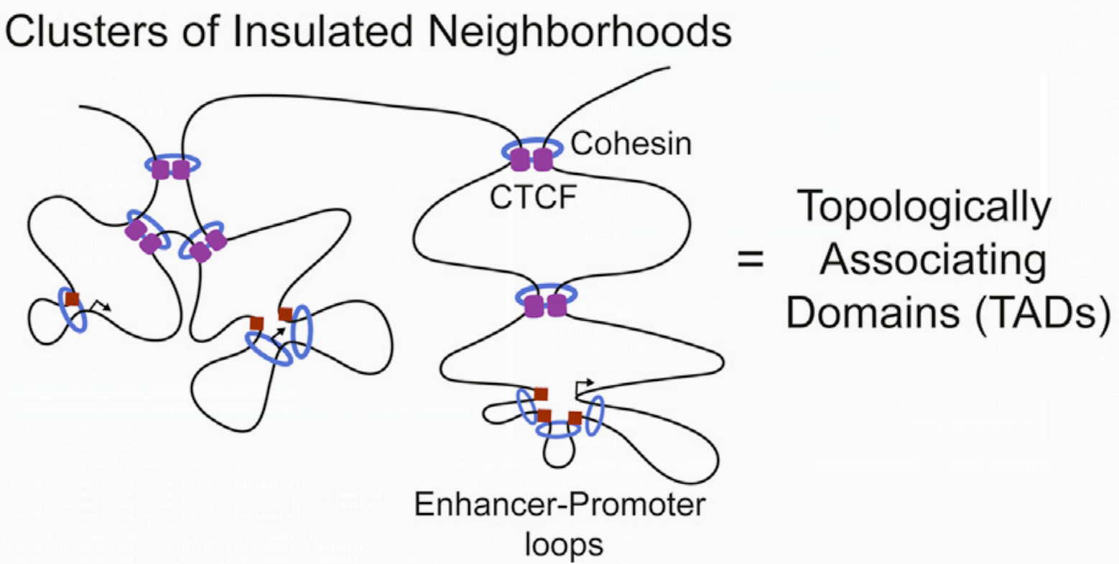
CTCF/cohesin roles in TADs
A new model for CTCF/cohesin loops in TADs was recently proposed
CTCF/cohesin loops are important for structural maintenance of TADs
Cohesin-only loops are smaller promoter-enhancer loops
Ji X, Dadon DB, Powell BE, et al. 3D Chromosome Regulatory Landscape of Human Pluripotent Cells. Cell Stem Cell. 2016;18(2):262-75.

Slide 31
Conclusions
ElincRNAs are enriched at loop anchors, but not significantly at TAD boundaries
Likely not involved in the maintenance of TAD boundaries
They are enriched in cohesin compared to other lincRNAs
Could be involved in enhancer-promoter looping
They are associated with TADs presenting more compaction
Could promoter these enhancer-promoter loops

Slide 32
Discussion
Ongoing debate : Transcript- or transcription-mediated functions of eRNAs in general
The mechanistic functions (if any) of spatial regulation by elincRNAs are probably case specific
Analysis is limited by the resolution of the technology
Only looking at intra-chromosomal contact. Interchromosomal and lamina contact might add interesting information

Slide 33
Outlook
Comparing enhancers producing elincRNAs vs those that do not would be more meaningful
Extending the analysis to other cell-lines may reveal interesting patterns

